Slide 1

Reliability
This section will introduce you to the distribution system reliability analysis module.

Slide 2
What is the reliability module?
Works in conjunction with the Powerflow module
Performs fault testing on a distribution system
Reports indices based around the IEEE 1366-2003 standard

Slide 3
How does it work?
Monitors meters and triplex-meters
Provides random faults to distribution
  Specified general object (e.g., overhead line)
  Specified fault
  Specified duration
  Specified frequency of occurrence
Performs the fault and analyzes results

Slide 4
Objects in Reliability Module
object eventgen {
char256 groups;
char256 targets;
double frequency[1/yr];
double duration[s];
char256 values;
}
Defines fault object category
Defines fault type
Defines fault circumstances

Slide 5
Objects in Reliability Module
object metrics {
char1024 report_file;
    }
Collects the system statistics
Relates results to “customers” (meters)
Outputs results to report_file (reliability.csv if unspecified)

Slide 6
Reliability Output
Log of events (if specified) – Fault locations and timing
SAIDI – System Average Interruption Duration Index
SAIFI – System Average Interruption Frequency Index
CAIDI – Customer Average Interruption Duration Index
CAIFI – Customer Average Interruption Frequency Index
CTAIDI – Customer Total Average Interruption Frequency Index
MAIFI – Momentary Average Interruption Frequency Index (not computed at this time)
ASAI – Average Service Availability Index

Slide 7


Reliability Output Explained
SAIDI – Total interrupt duration for average customer during defined time
SAIFI – Frequency average customer experiences a sustained interruption

Slide 8
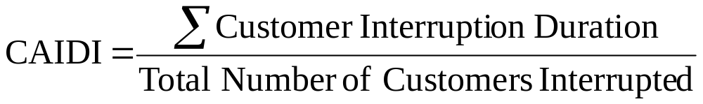

Reliability Output Explained
CAIDI – Average time required to restore service
CAIFI – Average frequency of sustained interruptions for customers experiencing sustained interruptions

Slide 9
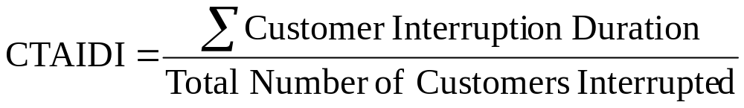
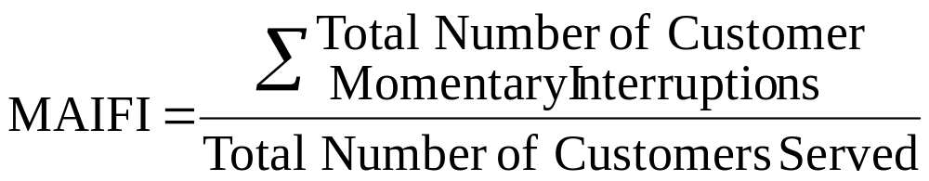
Reliability Output Explained
CTAIDI – Total average time customers experiencing an outage were without power
MAIFI – Average frequency of momentary interruptions

Slide 10

Reliability Output Explained
ASAI – Average fraction/percentage of time that a customer received power

Slide 11
Sample Reliability Output
Reliability report for reliability_test_new.glm
Number of customers: 3
EVENT LOG FOR YEAR 2000
=======================
Event DateTime Affects Prop Values T_int L_int N
1 2000-01-05 03:23:25 EST Link12 status OPEN 0.77 8614678.086 3
2 2000-01-29 12:19:53 EST Link34 status OPEN 0.38 2121.495 1
3 2000-01-30 11:52:49 EST Link12 status OPEN 0.06 8614678.086 3
4 2000-02-19 05:27:57 EST Link23a status OPEN 0.05 4081.820 1
.
.
27 2000-12-11 08:14:27 EST Link12 status OPEN 2.51 8614678.086 3
Annual reliability metrics report for 2000
==========================================
SAIDI SAIFI CAIDI CAIFI CTAIDI MAIFI ASAI
70774 15.00 4517 1.00 7582.91 (na) 86.534658

Slide 12
Exercises
Examine the example feeder and obtain the reliability result
Change the location of one line in the example feeder and examine the effect on reliability

